Slide 1
Donate via e-Transfer
The Church Assembly in Toronto

Slide 2
e-Transfer Account & Tax Receipts
The church has set up the following email address for e-Transfer: tcat.bank@gmail.com
It is important to make sure that you set up an e-Transfer Contact/Recipient with this email address
Early next year, we will email to you an Official Receipt for Income Tax Purposes for your total amount of donation in this year
For donation receipts, some banks (e.g. TD, CIBC, BNS) let us know your email address from your banking profile which we will use
For some banks (e.g. RBC), please provide your email address in the “Message” textbox when sending
For some banks (e.g. BMO), please enter your email address where prompted

Slide 3
e-Transfer Message Field
All donation received will be used for the general day-to-day operation of the church.
Please only use the “Message” field to provide your email address or to let us know that your e-Transfer is for payment of certain items/services.
Please do not use the “Message” field to designate your donation as gift for a specific person as all personal envelops must now be dropped into the offering box in the meeting hall.
Any e-Transfer with designation for any specific person will not be delivered, but instead will just be treated as a donation of the entire amount to the general fund.

Slide 4
Taking Care of Needy Saints
If you know of any brother or sister that requires financial assistance, please fellowship the need privately to any elder or co-worker. They will let the serving brothers know of such need, and the serving brothers will help the saint requiring help in the best way possible.
If the Lord so leads you, you may put some cash in an envelop, write on the envelop “for so-and-so”, and drop the envelop in the offering box in our meeting hall. This is called a personal envelop. The serving brothers will not open the envelop; and will deliver it to the person designated.

Slide 5
Contacts
If you have any questions, please contact:
Faithful Cheah (905) 201-1763
Hui Cai (647) 720-1783

Slide 6
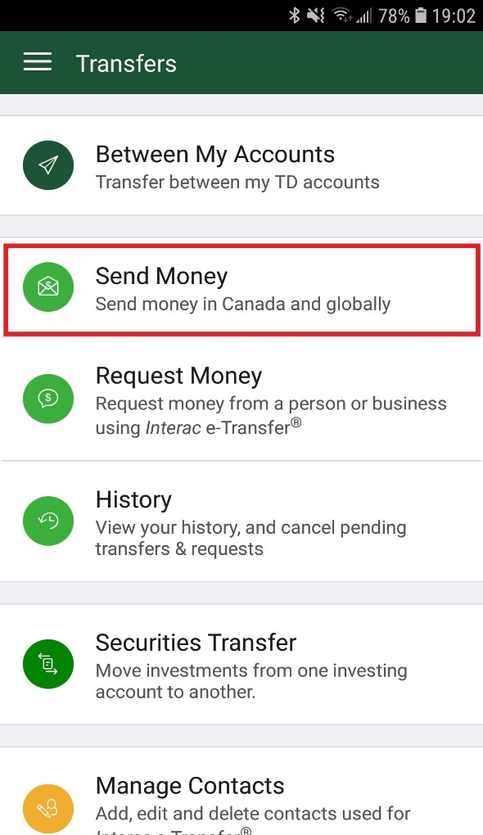

Toronto Dominion Bank 
Start the “TD Canada” APP, and from the “Transfers” screen, tap “Send Money”

Slide 7
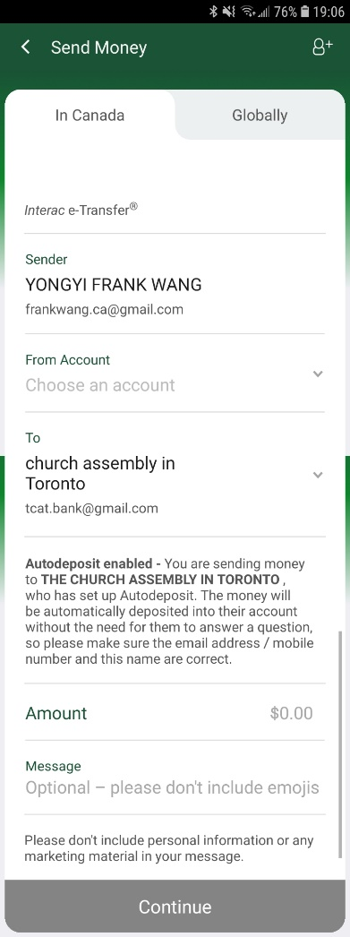
Toronto Dominion Bank 
Select the account to withdraw from
Ensure that tcat.bank@gmail.com is the Recipient
Enter the amount to donate

Slide 8
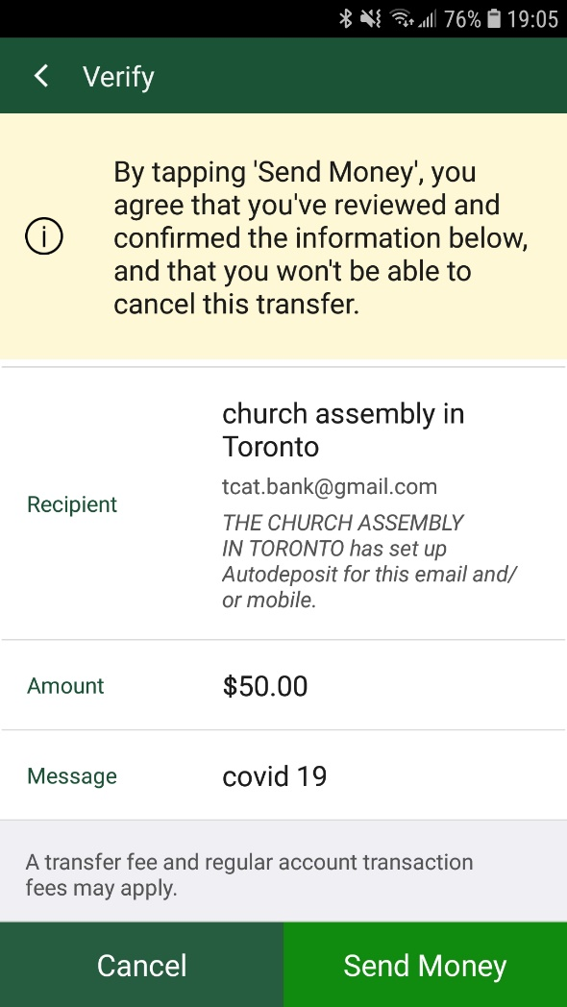
Toronto Dominion Bank 
Double check everything is correct, then tap “Send Money”

Slide 9

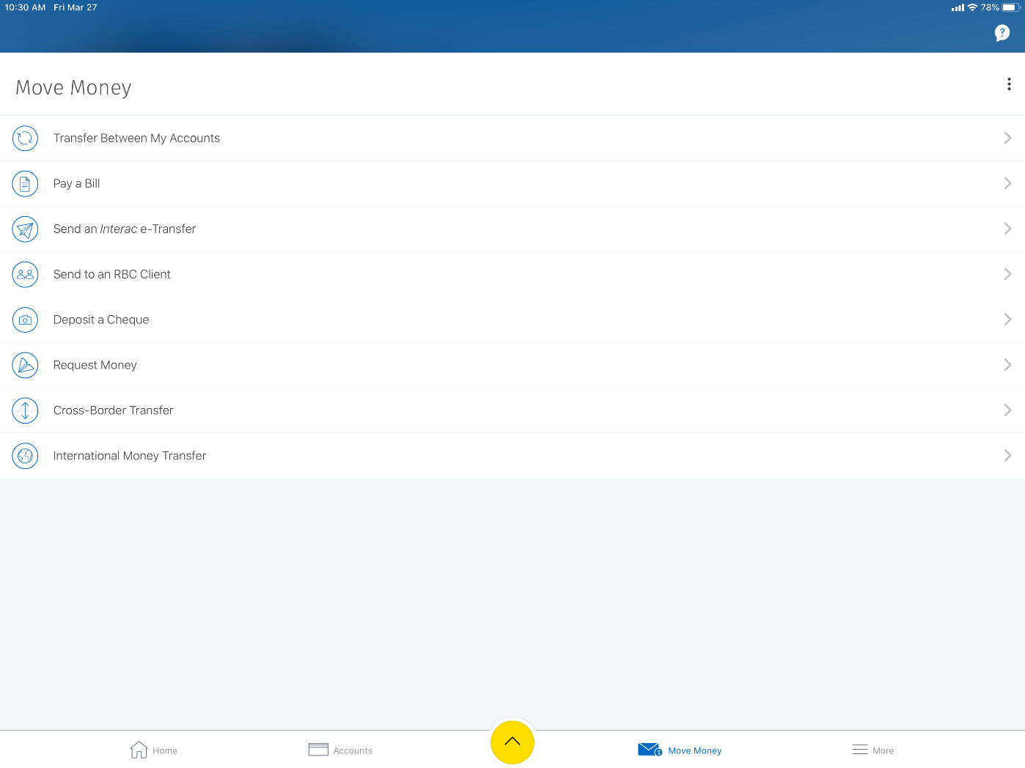
Royal Bank of Canada 
Start the “RBC Mobile” APP, and from the “Move Money” screen, tap “Send an Interac e-Transfer”

Slide 10
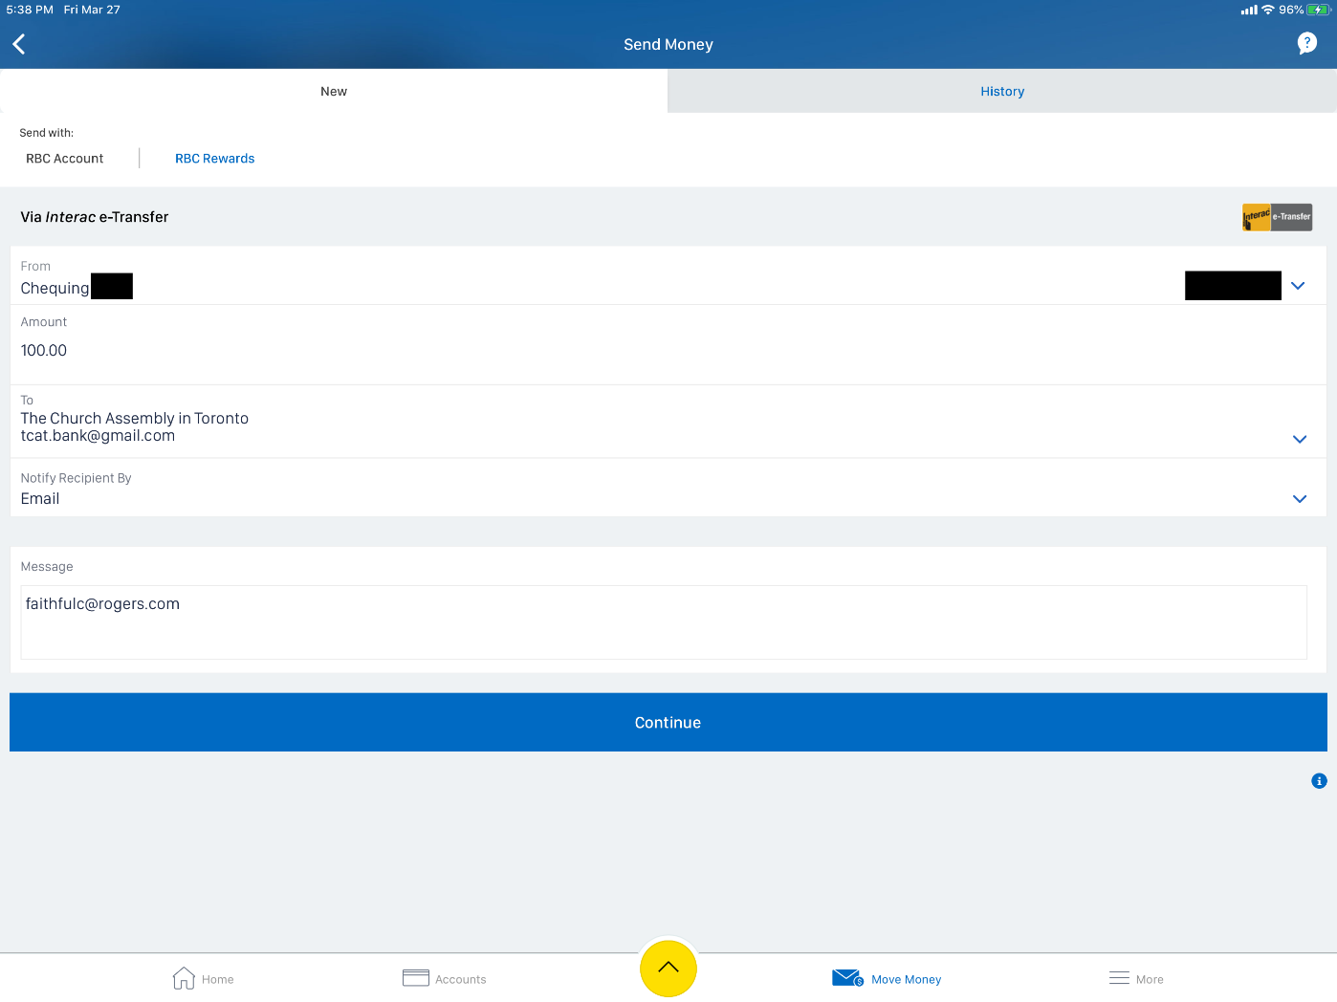
Royal Bank of Canada 
Select the account to withdraw from
Enter the amount to donate
Enter your email address for donation receipt
Ensure that tcat.bank@gmail.com is the Recipient

Slide 11
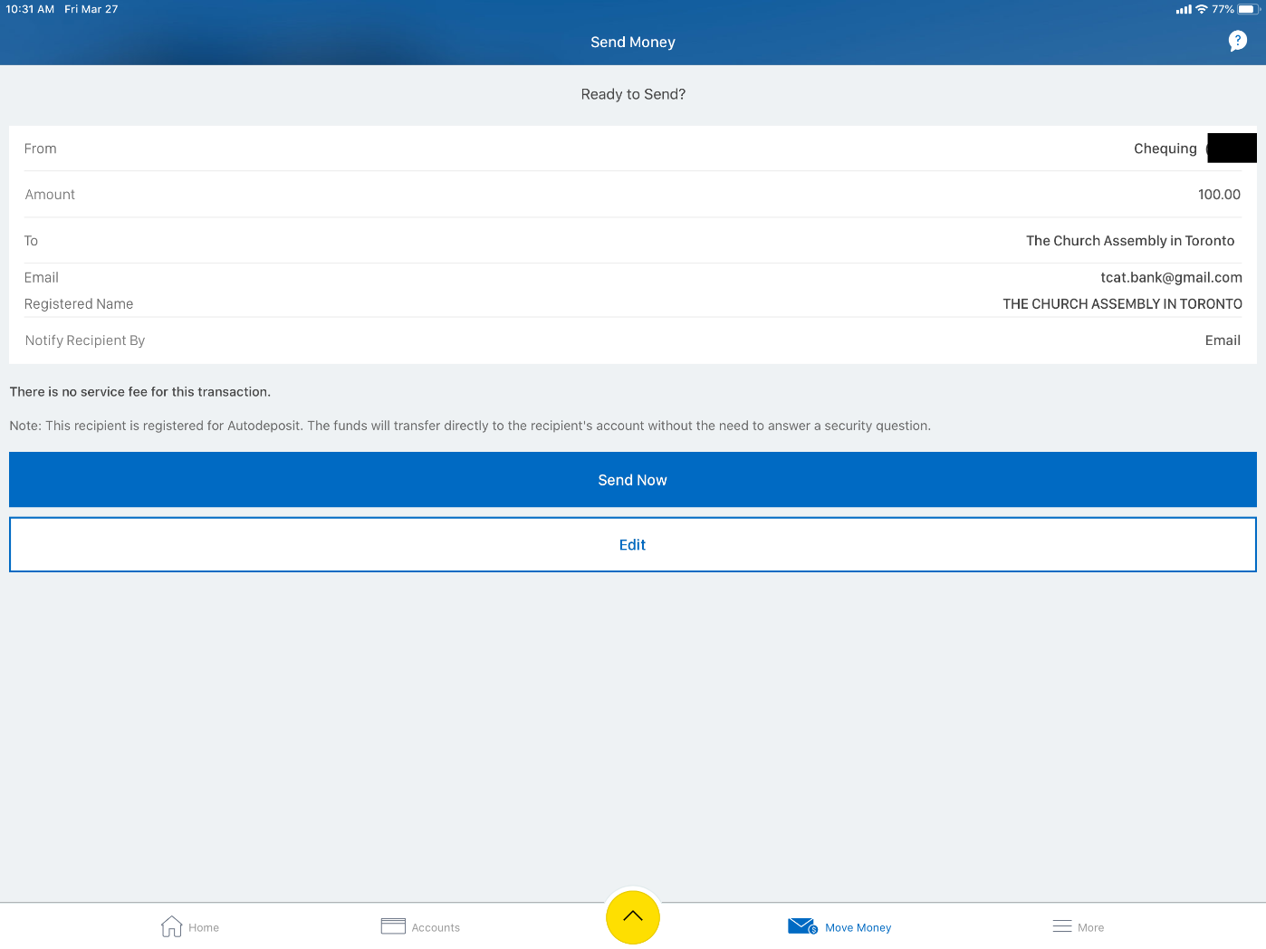
Royal Bank of Canada 
Double check everything is correct, then tap “Send Now”

Slide 12

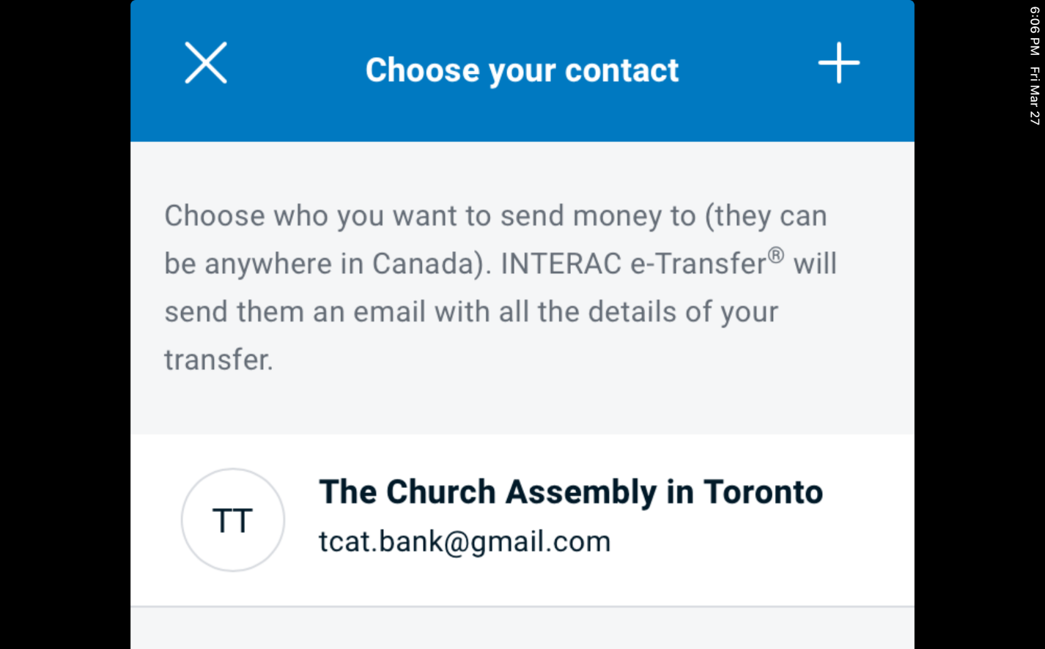
Bank of Montreal 
Start the “BMO Mobile Banking” APP, tap “Pay & Transfer”, followed by “INTERACT E-TRANSFER”
Add / Choose tcat.bank@gmail.com as Contact

Slide 13
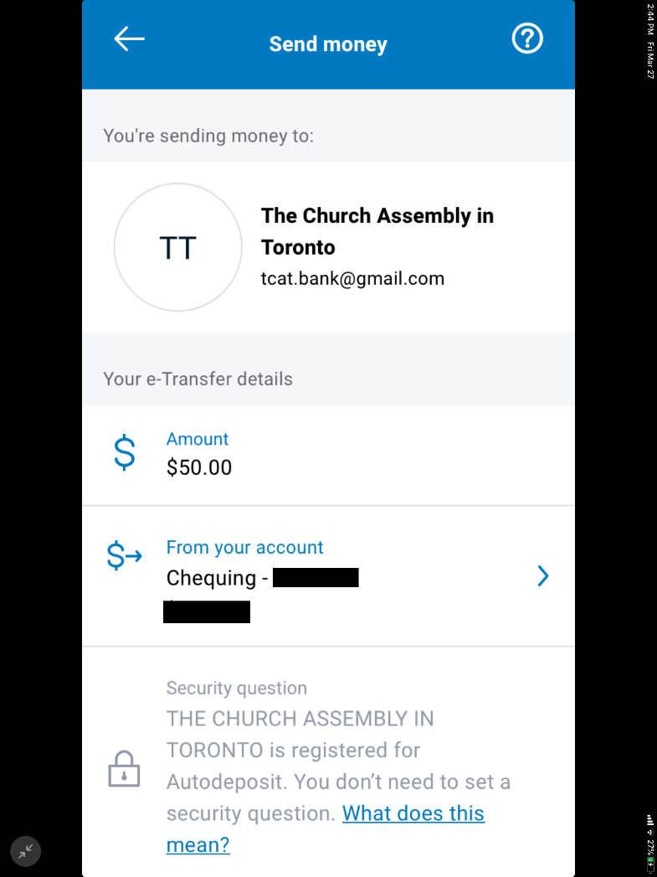
Bank of Montreal 
Enter the amount to donate
Select the account to withdraw from

Slide 14
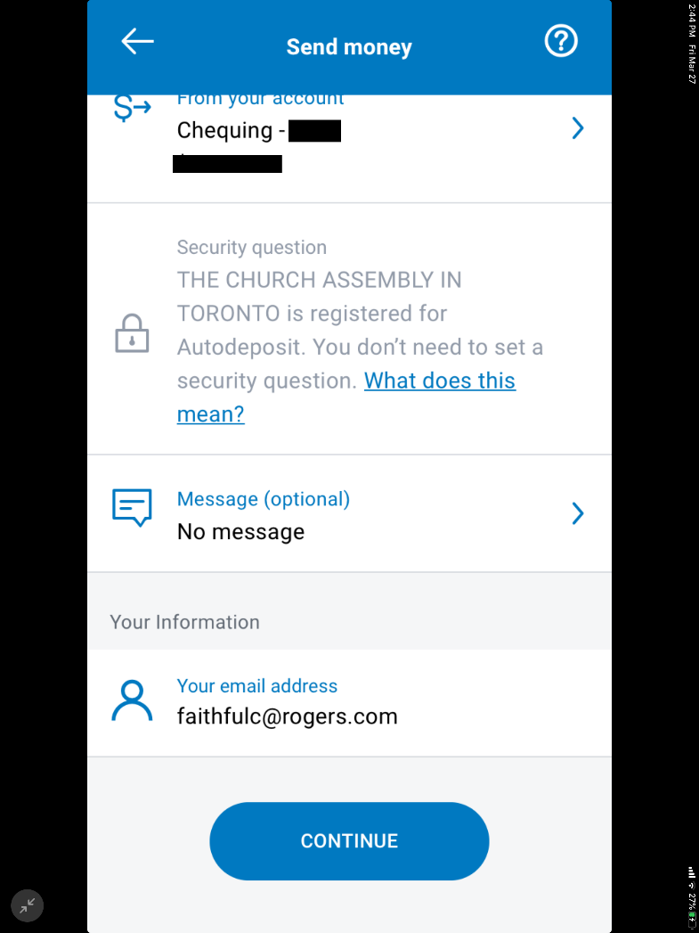
Bank of Montreal 
Enter your email address for donation receipt

Slide 15
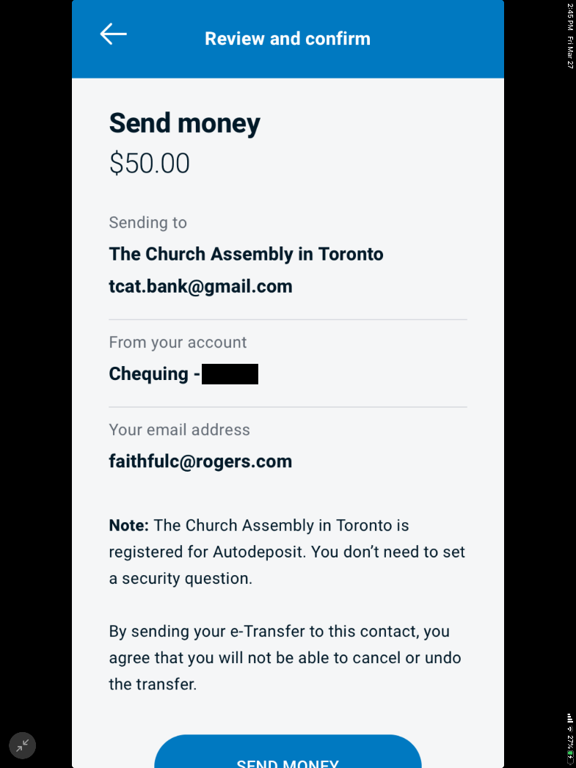
Bank of Montreal 
Double check everything is correct, then tap “Send Money”

Slide 16

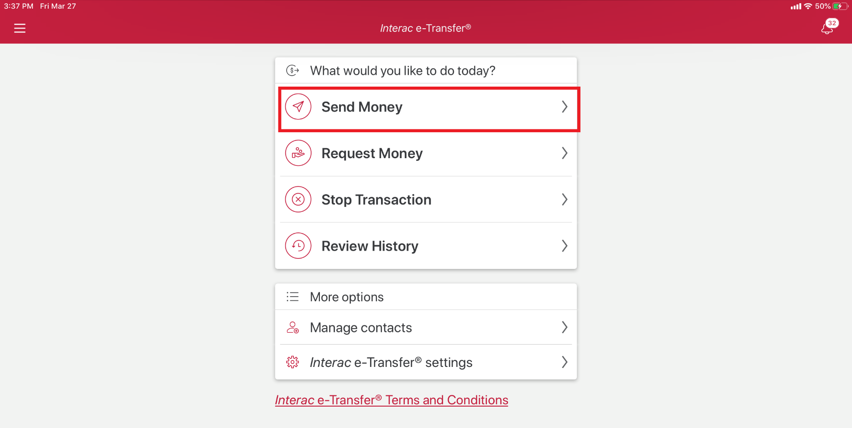
Canadian Imperial Bank of Commerce 
Start the “CIBC Mobile Banking” APP, and from the “Interac e-Transfer” screen, tap “Send Money”

Slide 17
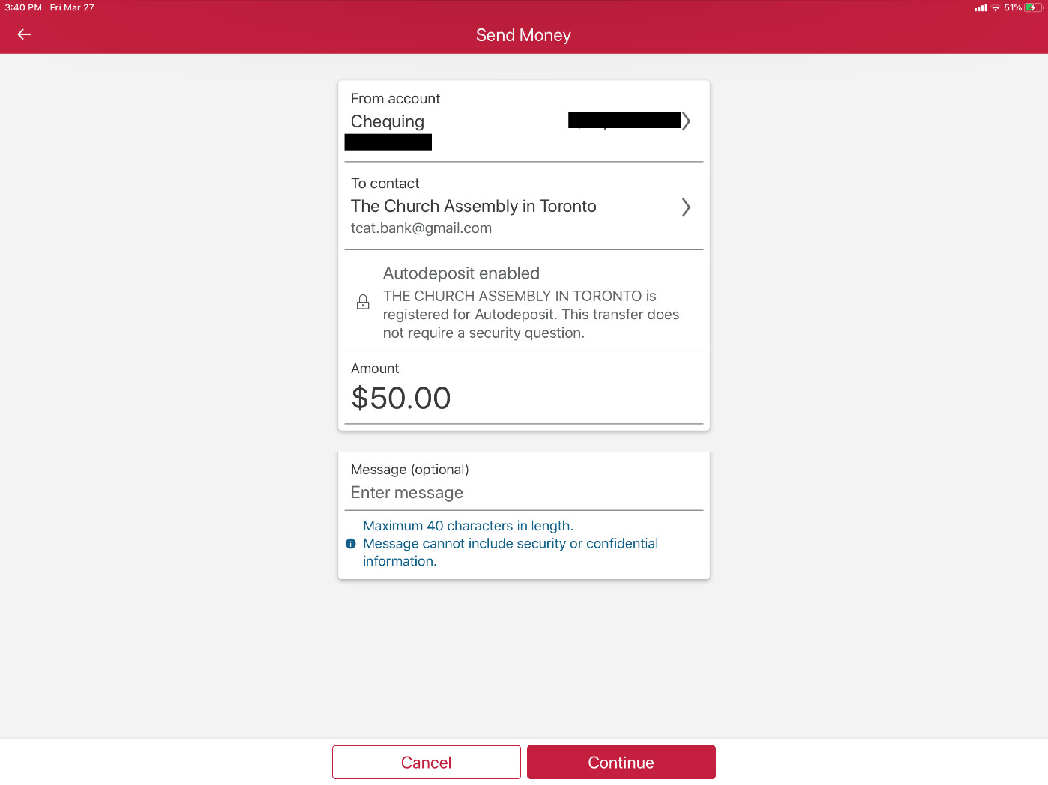
Canadian Imperial Bank of Commerce 
Select the account to withdraw from
Enter the amount to donate
Ensure that tcat.bank@gmail.com is the contact
Double check everything is correct, then tap “Continue”

Slide 18
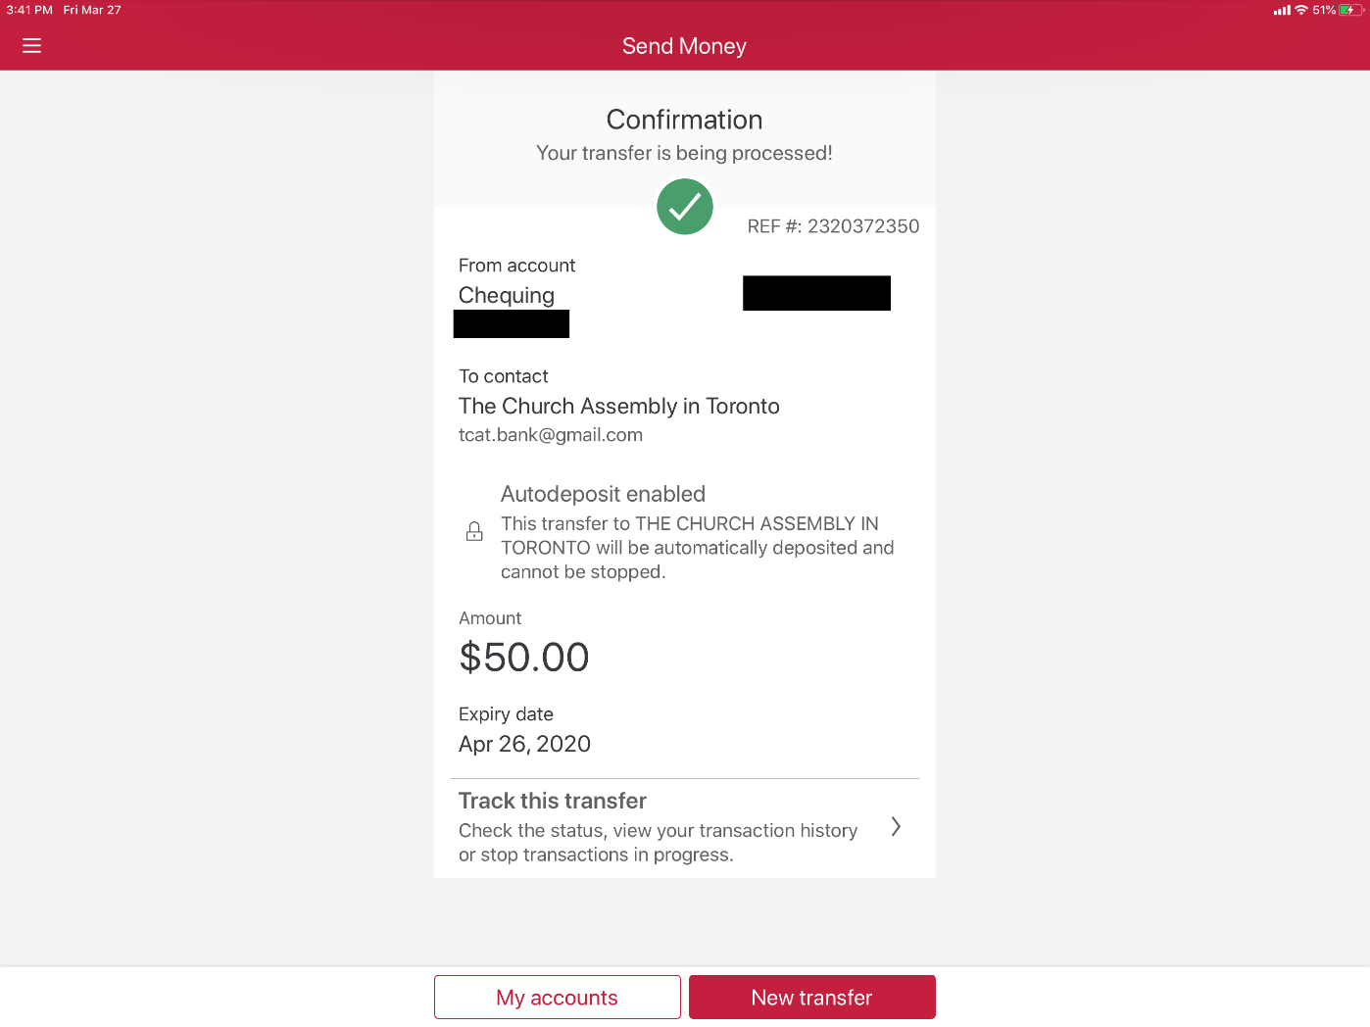
Canadian Imperial Bank of Commerce 
Confirmed

Slide 19

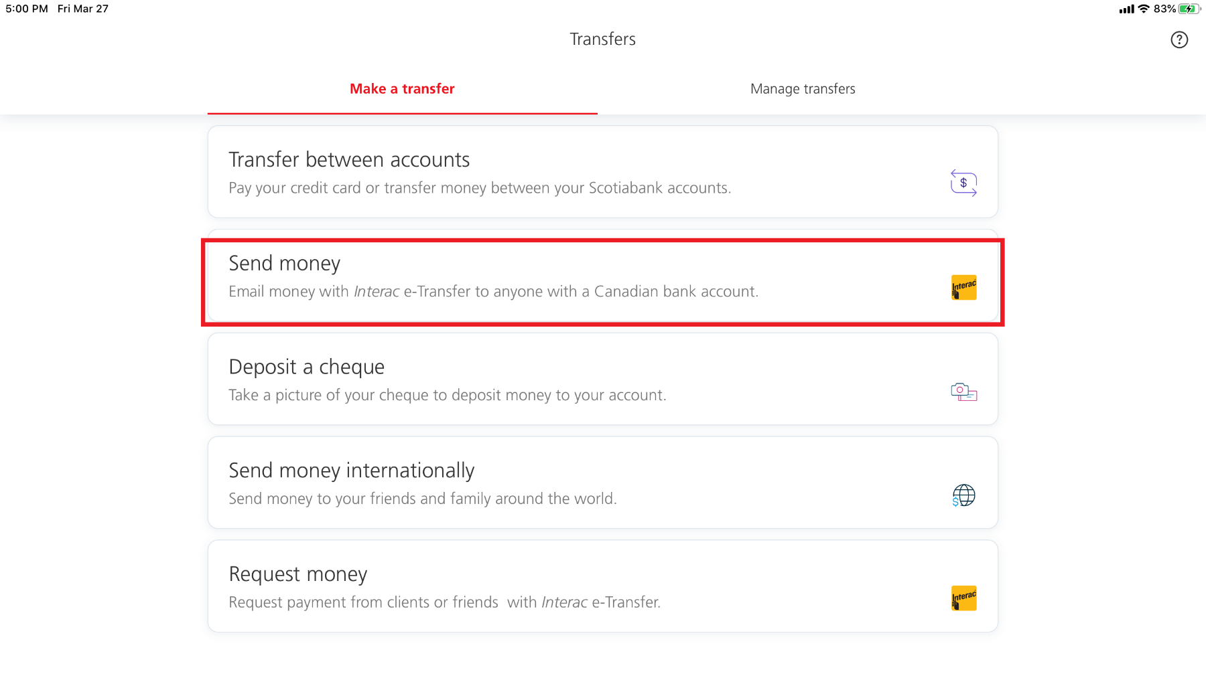
Bank of Nova Scotia 
Start the “Scotiabank” APP, and from the “Transfers” screen, tap “Send money”

Slide 20
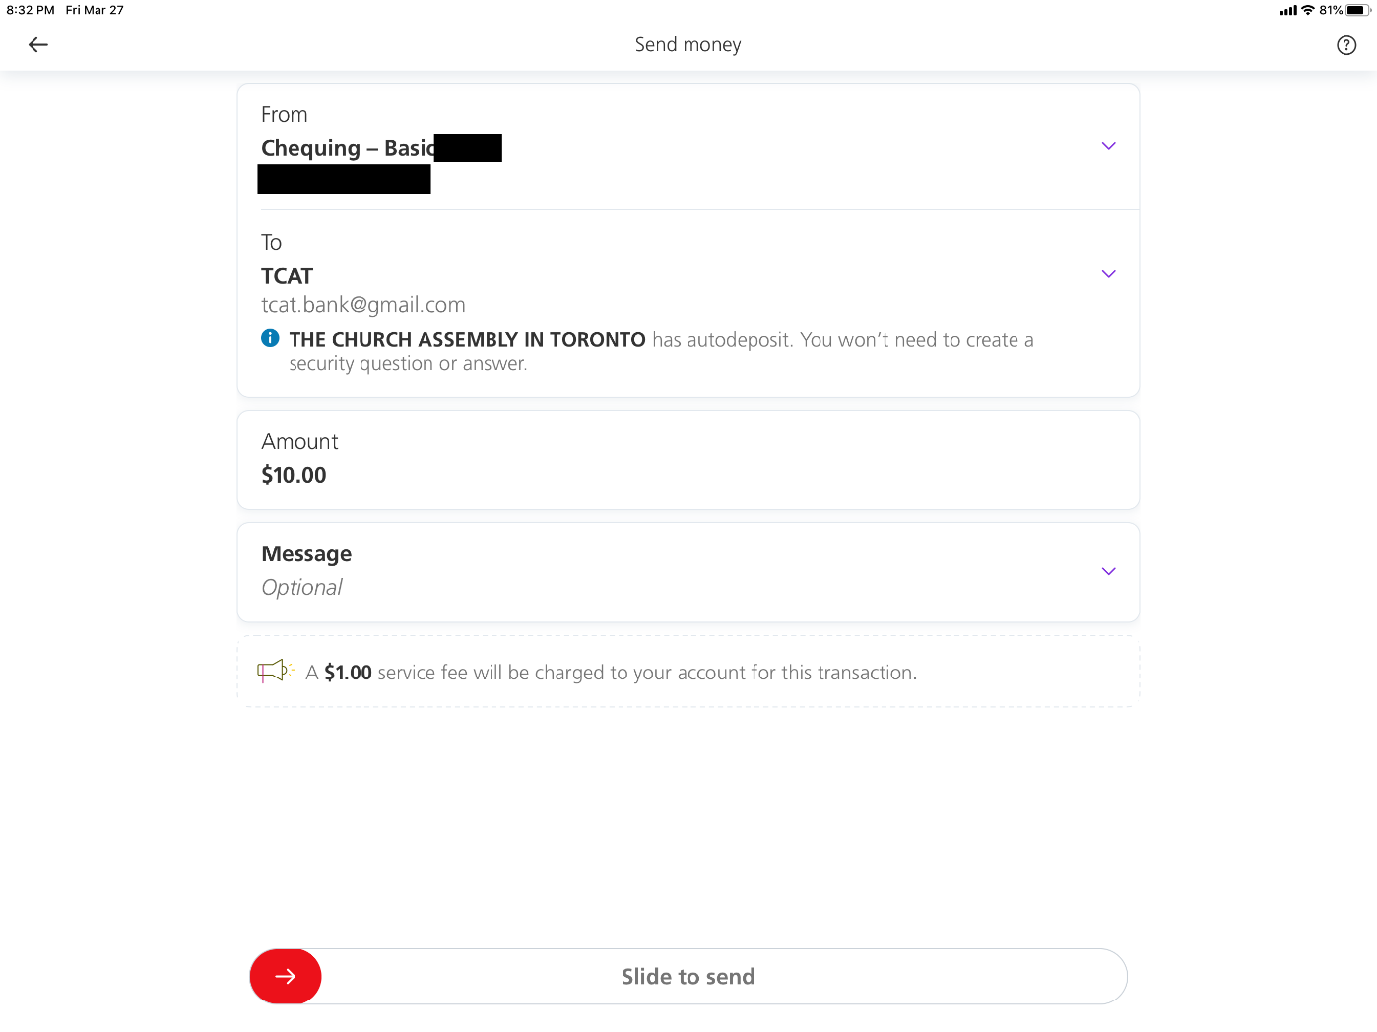
Bank of Nova Scotia 
Select the account to withdraw from
Ensure that tcat.bank@gmail.com is the Recipient
Enter the amount to donate
Double check everything is correct, then slide her to send

Slide 21
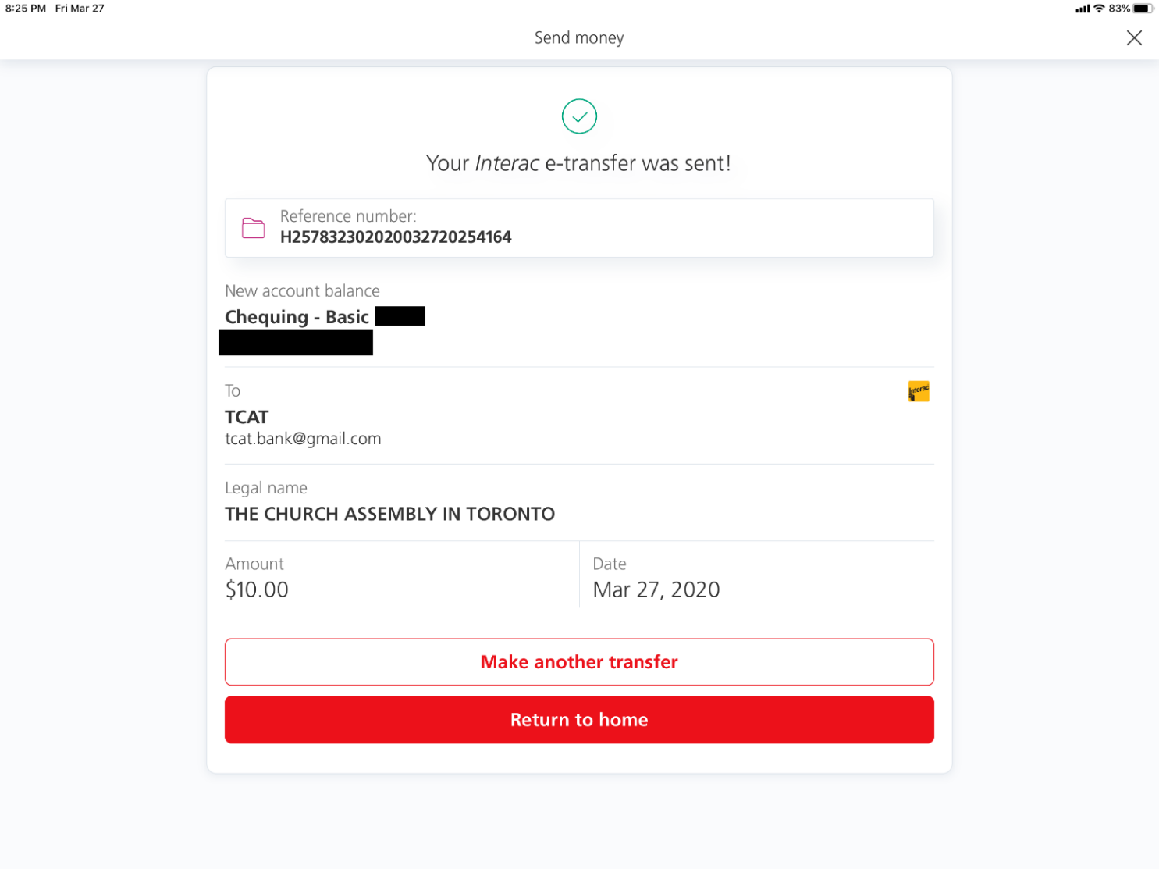
Bank of Nova Scotia 
Confirmed

Slide 22
An Opportunity to be Blessed
What God has given us today, in His loving kindness, is an opportunity of a lifetime. No, to be exact, several lifetimes. An opportunity to experience His intimate presence casting out all worries and fears. An opportunity to find Him as our refuge and underneath are the everlasting arms.
Having been thus blessed, sheltered, and secure in Him, may we also see the needs around us, and say, “Lord, here am I, make me a blessing to someone today.” Indeed He blesses us so that many more may be blessed through us. May none of us fall short in this occasion and fail to bless someone today.

